Slide 1
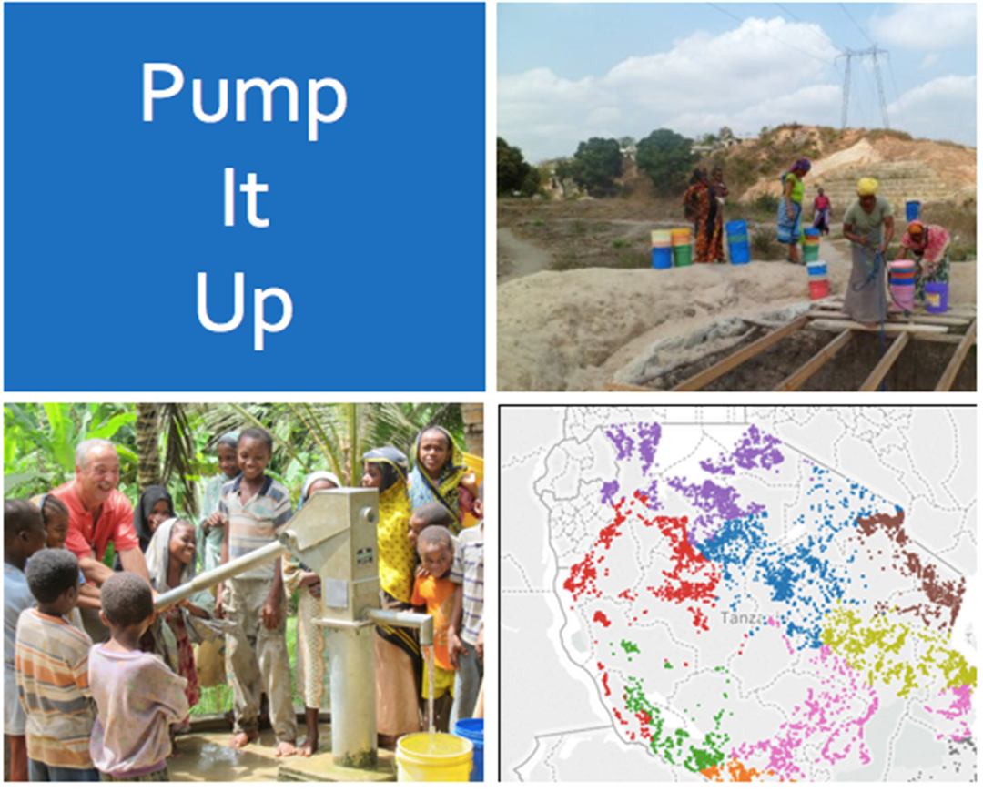
Predicting the Operating Condition of Tanzanian Wells
Tanzanian Water Ministry
BOD Slides
Carlos Fuentes
Robert Herold
Chris Pelkey
Susan Poole

Slide 2
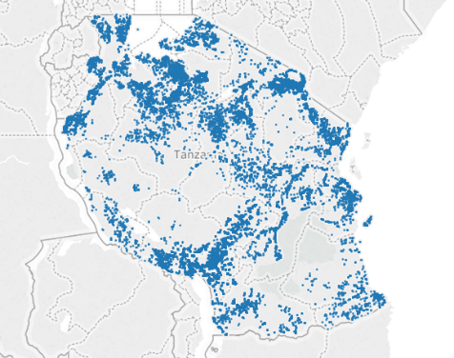
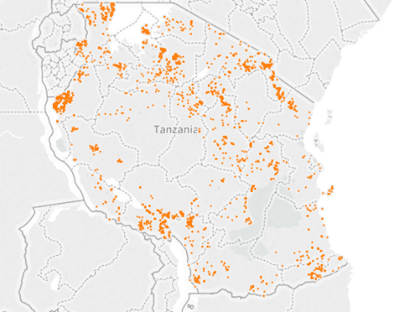
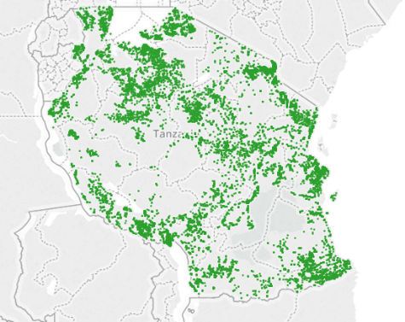
Executive Overview
Functional Wells
Problem Statement
Data Quality, Data Transformations and Exploratory Data Analysis
Deliverables
Predictive Model
Modeling Tool Recommendation
Data Visualizations
Recommended Next Steps
Problem Statement
Functional Wells Needing Repair
Non Functional Wells
Problem Scope
59,400 wells across 365,756 square miles serving 51.82 million people
International donor pressure to optimize well maintenance
How We Are Helping
Predicting which wells are likely to fail
Optimizing resources
Changing model from reactive to proactive
Importance of Water and Wells
Lynchpin of a healthy and stable society
Water scarcity leads to local food supply collapse and civil unrest

Slide 3
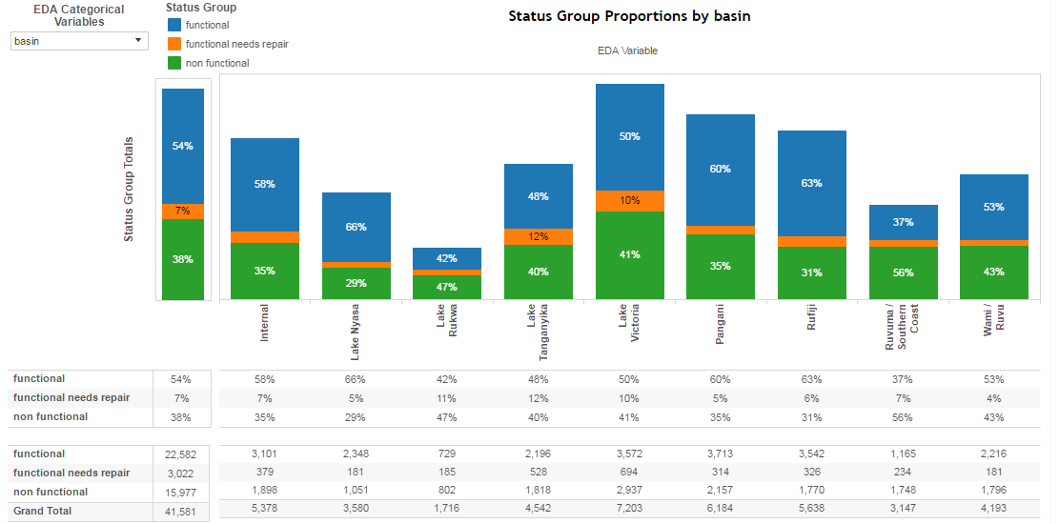
Data
Quality
Data
Transformation
Method
Missing Data
Data Imputation
missForest
(tree-based)
Combine levels with smaller numbers of observations
Group levels with less than a specified percentage of the observations
High Cardinality
Numeric Variables: Center and Scale
Categorical Variables: Dummy Coding
Nonstandard Data
Data Standardization
Exploratory Data Analysis
Enhanced through the creation of an EDA dashboard using Tableau business intelligence software
Allows each team member to perform their own EDA and choose the variables they would like to analyze

Slide 4



Predictive Model
Multiple models were constructed using R, Azure software and Angoss software to identify which performed most favorably with regard to predictive accuracy of the test data
Predictive Model Recommendation: Random Forest Model created using R
R Models | Accuracy – Test Data
Random Forest | 0.8080
Gradient Boosting | 0.8013
Bagging | 0.6964
Deep Learning Neural Network | 0.7688
Support Vector Machine | 0.7893
Multinomial Regression | 0.7477
Azure Models | Accuracy – Test Data
Multiclass Decision Forest | 0.80156
Multiclass Decision Jungle | N/A*
Multiclass Neural Network | 0.781413
Multiclass Logistic Regression | 0.743869
*Exceeded1 Hour of CPU Time
Angoss Models | Accuracy – Test Data
Random Forest | 0.7553
Bagging | 0.7468
Deep Learning Neural Network | 0.736

Slide 5
Modeling Tool Evaluation
Modeling Tool Recommendation: R
Our team currently recommends that the ministry leverage R because of the superior accuracy and absence of recurring costs
Feature | R | Azure | Angoss
Economics | Free | Recurring costs | License & yearly maintenance fee
Skill Set | Specialized | Average | Average
Timeliness | Low | High | Moderate
Accuracy | High | Out of the box feature - Medium Specialized resources - High Custom extensions in R - High | Out of the box feature - Medium Specialized resources - High Custom extensions in R - High
The below chart includes recommendations on when to use each program
Need | Specification | Technology
Imputing Missing Data | Need to quickly impute data, where a high degree of accuracy is not required | Azure
 | Need a high degree of accuracy when immediacy is not required | R
Model Building | Need reasonably accurate response within hours | Azure
 | Need a high degree of accuracy when immediacy is not required | R

Slide 6
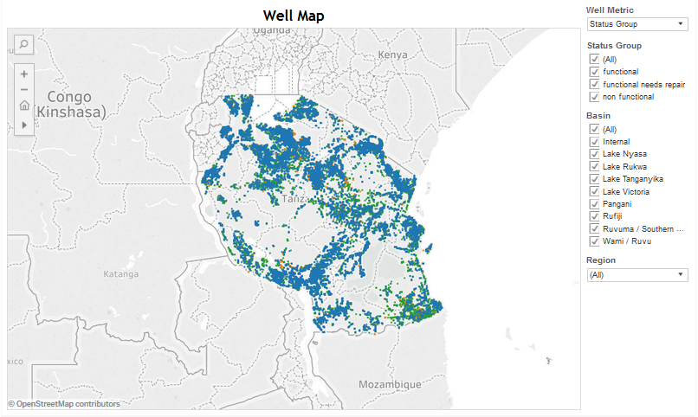
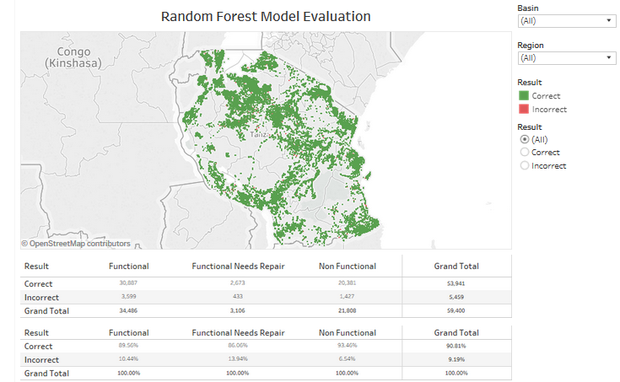
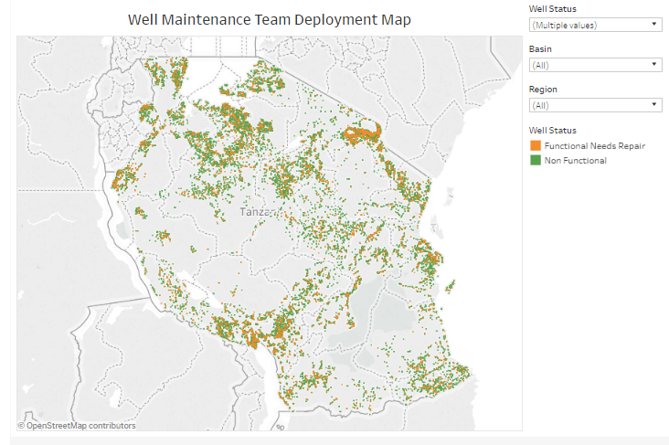
Data Visualization: Tableau
Click Images to View Dashboards
Exploratory Well Map
Random Forest Model Evaluation Map
Well Maintenance Team Deployment Map
Interactive EDA (Slide 3):
Click to Here View
Recommended Next Steps
Database Improvement
Determine missing values and populated when feasible.
Clearly denote which entries are unavailable rather than populating with zeros.
Predictive Model Refresh
Periodic review of the model to ensure that the algorithm used to predict well status is modified when appropriate.
Review of the Azure software option in 18 – 24 months to determine whether it would be a more suitable option at that time.

